Slide 1
Introduction to Clustering
Notes:
This lecture is a theoretical introduction to clustering. It also discussed clustering as a form of unsupervised learning and presents the k-means clustering algorithm

Slide 2
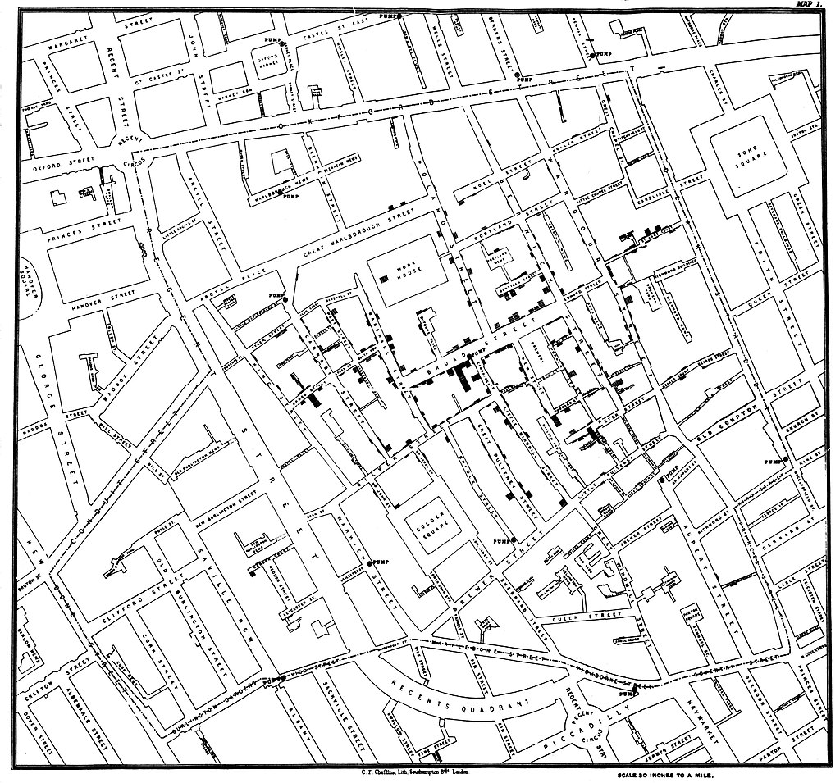
Cholera cases (black rectangles)
in London epidemic of 1854
Physician John Snow proposed
epidemic caused by contaminated water
Identified contaminated water pump
(other pumps too far away)
Notes:
An early example of clustering with life-saving consequences.
Original map by John Snow showing cholera cases (indicated by stacked rectangles) in the London epidemic of 1854. Snow found that the cases formed a large cluster all close together, which suggested a common origin. The contaminated pump is located at the intersection of Broad Street and Cambridge Street (now Lexington Street), running into Little Windmill Street (show with blue circle). Other pumps(green circles) are too far away from outbreak to be the culprits.
By plotting and clustering the data, physician John Snow argued that the cause of the epidemic was germ-contaminated water and not “bad air” as was commonly believed (Snow made his argument before the germ theory was established). His work lead to improvements in sanitation and public health.
For more information see https://en.wikipedia.org/wiki/1854_Broad_Street_cholera_outbreak

Slide 3
# purchases per month
Many
Few
Total spent
(USD)
Little
Lots
Notes:
Consider an example inspired by retail. For simplicity, customers of your store have two attributes: total amount spent per month and # purchases per month. Plot the data.
First point: you only have 13 customers per month. That might be a problem.
Second point: see they fall into two groups

Slide 4
# purchases per month
Lavish
Many
Frugal
Few
Total spent
(USD)
Little
Lots
Notes:
Retail example continued.
Combine all customers that spend little and make few purchase into one group (“a cluster”). Call this group “Frugal”.
Similarly, group the customers who spend a lot of money and do so many times a month into the “Lavish” cluster.
You’ve carried out a clustering algorithm. And now you can target your ads appropriately to each type of customer.
Now you have a new customer, who is close to the Frugal cluster, so add the customer to that cluster.

Slide 5
# purchases per month
Lavish
Many
Frugal
Noise? Anomaly?
New cluster?
Group with Lavish?
Few
Total spent
(USD)
Little
Lots
Notes:
Retail example continued.
Now there’s another new customer. This one is more complicated. Not obvious what to do. Will depend on domain expertise, other information about customer (if available) and resources available (creating a new cluster with its own ad campaign costs money).

Slide 6
Motivation: clustering provides insight
mechanism/motivation
connectivity/correlations
simplification/convenience
Notes:
1.Mechanism/motivation—Can provide deep insights, but hard to find. Example: clustering of galaxies→ modern cosmology
2. Connective/correlations—Reminder: correlation is not causation, but sometimes correlation can lead to the mechanism
Examples: cholera outbreak (correlation leads to mechanism); text analysis (correlation does not lead to mechanism)
Text analysis—distill online customer reviews to keywords and then cluster these to understand customer feedback
3. Simplification/convenience—too much data to process individually; clustering makes it easier/practical.
Example: group customer body types into five T-shirt sizes (XS, S, M, L, XL)

Slide 7
What’s a cluster?
Intuitive definition:
group of data points that are close to each other
To make this computer friendly, need a mathematical definition of “close.”
Close (most common definitions):
based on distance or density
Notes:
Intuitive definition: humans good at recognizing clusters by eye, but a computer program needs a strict definition
Distance: require a metric e.g., Euclidean distance between data points
Density: number of other data points within a specified distance
Will explore different definitions in the “Other_Clustering_Algorithms” lecture.

Slide 8
Clustering as unsupervised learning
algorithm
Unlabeled data
Structured data
assignment
New data
(unlabeled)
New data included
in structure
Notes:
Clustering algorithms are an example of a broader category of machine learning algorithms: unsupervised learning
Unsupervised learning: data is unlabeled (don’t have correct answer). Algorithm (clustering, neural network) deduces relationship between the elements of the data from the data itself. Contrast with supervised learning (e.g. classification) where there is some labeled data on which to train the model.
Once data exists in a structured form, new data is included in the structure through assignment rules, which may be different from the rules of the initial algorithm.

Slide 9
Clustering vs. partitioning
Clustering:
points MAY be assigned to a cluster;
could also be outliers
Partitioning:
points MUST be assigned to a cluster;
no other categories
Notes:
Terminology: clustering and partition are often used as synonyms, but they aren’t
As we will see, some algorithms that are considered clustering algorithms are actually partitioning algorithms.
Partitioning algorithms are simpler (fewer parameters), but also more rigid as they don’t allow for the possibility of data that isn’t in a cluster.
Here outlier is used as a catch-all category. Outlier includes both noise and anomaly.

Slide 10
k-means clustering
Notes:
A popular algorithm for cluster analysis due to its simplicity

Slide 11
k-means clustering*
A partitioning algorithm that divides the data into k clusters
Points are assigned to a cluster based on metric
(such as Euclidean distance) to nearest cluster centroid
Value of k is chosen by the user
*An example of clustering vs. partitioning confusion
Notes:
Since a distance is involved, must specify metric. The Euclidean distance is the one most commonly used.

Slide 12
k-means clustering: the algorithm
Choose k centroids
2. Assign points to cluster based on nearest centroid
3. Recompute centroids
4. Repeat steps (2) and (3) until algorithm converges
Notes:
Converge: centroids no longer move or equivalently, cluster assignments no longer change

Slide 13
k-means: toy example
Notes:
Toy example: four points at the corners of a rectangle.
Choose k=2 with initial centroids as shown

Slide 14
k-means: toy example
Notes:
Assign points to cluster based on nearest centroid

Slide 15
k-means: toy example
Notes:
Recompute centroids
With new centroid positions, cluster assignments no longer change, so k-means terminates

Slide 16
k-means: strengths and weaknesses
Strengths:
Simple—one parameter (k clusters)
Typically fast—for n points in d-dimensions, runtime is O(nkdi)
where i is number of iterations until convergence
Guaranteed to converge
Easy to implement
Weaknesses:
Optimal k is often not obvious
Can get trapped in local minima (initial conditions matter)
Sensitive to outliers (partitioning not clustering)
Scaling affects results
Notes:
List offers highlights, but is not exhaustive.
Another strength: many variants readily available
Another weakness: get spherical clusters, hard to deal with clusters of different density
In following slides will address first two weaknesses.
Note on runtime:
The running time of k-means algorithm (and most variants) is O ( n k d i ) where n is the number of d-dimensional vectors, k the number of clusters and i the number of iterations needed until convergence. On data that does have a clustering structure, the number of iterations until convergence is often small, and results only improve slightly after the first dozen iterations. The k-means algorithm is therefore often considered to be of "linear" complexity in practice, although it is in the worst case superpolynomial when performed until convergence.
Adapted from https://en.wikipedia.org/wiki/K-means_clustering

Slide 17
k-means: How to choose k
If you have an external constraint or domain knowledge, use it!
Example: customer segmentation study for a bank
that offers five types of savings account → k = 5
What if you don’t have such knowledge?
Or you are exploring the possibility of offering more/fewer types
of savings accounts?
Notes:
We will look at two ways to choose k in the absence of external constraint or domain knowledge: inertia and silhouette coefficient, which are measures of k-mean performance

Slide 18
k-means performance: inertia
Idea: good clustering → points close to cluster centroids
Quantify this idea: sum of squares of distances of points
from corresponding cluster centroid should be small
Give it a name: call this sum inertia

Slide 19
k-means performance: inertia
sum over clusters
position of centroid
of cluster j
sum over points
in cluster j
position of point i
in cluster j

Slide 20
k-means performance: inertia
Intuition: want I as small as possible
Problem: I ≥ 0
Minimum is zero, which occurs in two (useless) cases:
All points at same location (I = 0 for all k)
Number of clusters = number of points (k = n)
Notes:
Can’t simply minimize I to get k.

Slide 21
k-means performance: inertia
inertia
Inertia for
toy example
Choose k
at “elbow”
1
2
3
4
Notes:
Compromise: look for large drop in I followed by slower decrease. Choose value of k at the “elbow”
Use toy example as illustration. In this case, k=2, 3, and 4 points lie on a straight line. This is not always the case.
In fact, while shape above for the inertia curve resembles the typical one, the curve does not always have to have this shape. For example, it is possible for an inertia curve not to have an elbow.

Slide 22
k-means performance: silhouette coefficient
Idea: good clustering → points close to cluster centroids
and far away from other clusters
Quantify this idea: compare two distances for each point i
a(i): intra-cluster distance
b(i): inter-cluster distance
Give it a name: call this metric silhouette coefficient
Calculate metric based on ratio
Notes:
Silhouette coefficient is also called ‘silhouette score’ or just ‘slihouette’
For good clustering a << b (a/b << 1)

Slide 23
k-means performance: silhouette coefficient
a(i): mean distance between i and all other points in same cluster
b(i): mean distance between i and all other points in nearest cluster
that does not include i
silhouette
coefficient
Notes:
For good clustering a << b (a/b << 1) → s approximately 1
Poor clustering a >>b (b/a << 1) → s approximately -1
Note: for clusters with size =1, s(i) =0.

Slide 24
k-means performance: silhouette coefficient
poor clustering
good clustering
Choose k such that average silhouette coefficient
over all clusters is largest
Notes:
Can also look at distribution of silhouette coefficients within each cluster as shown in the example below:
https://scikit-learn.org/stable/auto_examples/cluster/plot_kmeans_silhouette_analysis.html#sphx-glr-auto-examples-cluster-plot-kmeans-silhouette-analysis-py

Slide 25
k-means: local minima
Notes:
Toy example: four points at the corners of a rectangle.
Choose k=2. Before we chose initial centroids near short edges.

Slide 26
k-means: local minima
Notes:
Now choose initial centroids near long edges.

Slide 27
k-means: local minima

Slide 28
k-means: local minima
Notes:
Algorithm converged, but clustering is different to previous result.

Slide 29
k-means: toy example
Notes:
Previously, better clustering: inertia smaller, silhouette coefficient is larger.

Slide 30
k-means: local minima
Moral: run k-means for various initial centroid guesses
Notes:
We reached a suboptimal result because of initial conditions. Therefore, it is important to run k-means not only with different k, but also with different random guesses for initial centroids.
Another approach: k-means++, in which successive centroids are selected from a weighted probability distribution, with a probability proportionality to the square of the distance from the previous centroid. Leads to better clustering.

Slide 31
k-means: adding new data
1. Add new data to nearest cluster
2. Treat clusters as labeled data
Use this data to train a classifier
Apply classifier to new data
Notes:
First approach is a kNN algorithm with k=1. Quickest approach.
Second approach is more robust assuming k-means results are not severely erroneous.
Eventually, if enough new data is added, k-means must be rerun.

Slide 32
Summary
Clustering: unsupervised learning technique for grouping data
k-means clustering: simple and popular partitioning algorithm
One parameter
Typically fast
Choice of k requires judgment
Implemented in scikit-learn
from sklearn.cluster import Kmeans
https://scikit-learn.org/stable/modules/generated/sklearn.cluster.KMeans.html

Slide 33
Questions?

